Slide 1

ML Demo - Fraud Detection
“Infinite possibilities with Technology”

Slide 2

01
Identification of data source
02
Data cleaning & pre-processing
Table of
Contents
03
Model Training
04
Output Analysis
Prediction
05

Slide 3
Identification of data source
Data cleaning & pre-processing
Model Training
Output Analysis
Prediction
To improve fraud detection in the loan lending industry, we utilized a multi-collectional dataset:
Loan Application Data: Captured essential information. Key Features: Total Income Amount, Credit Amount, Amount of Days Employed
Credit Bureau Data: Analyzed detailed credit history, including repayment performance, credit utilization, and credit inquiries, to assess creditworthiness.
Credit Card Statements: Analysed monthly spending patterns, transaction types, and payment behavior to identify unusual patterns. Key Feature: Monthly Balance, Credit Card Limit, Amount of Money Drawn
Previous Loan Applications: Reviewed application outcomes, reasons for approval or rejection, and any associated risk factors. Key Feature: Down Payment Amount, Application Credit Amount
Transaction Data: Analyzed transaction history, including merchant categories, transaction amounts, and frequency, to understand spending habits. Key Feature: Installment Amount, Payment Amount

Slide 4
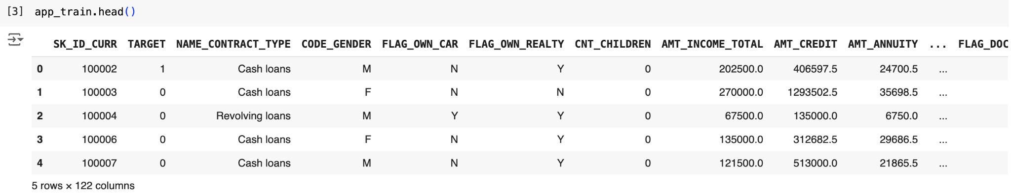
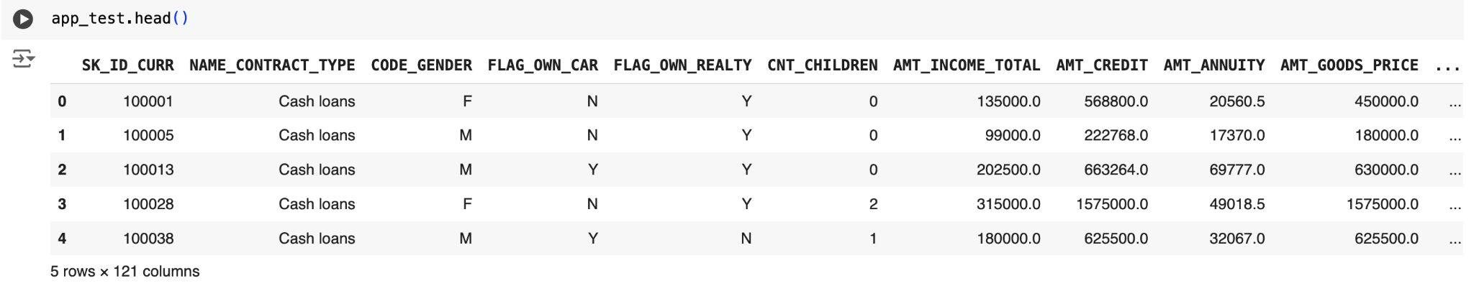
Loan application dataset
Train data-set
Test data-set

Slide 5
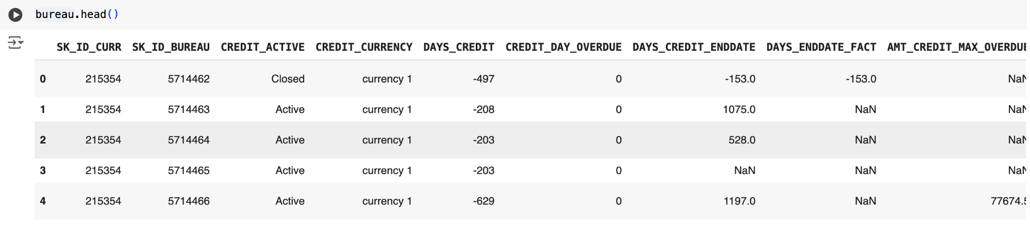
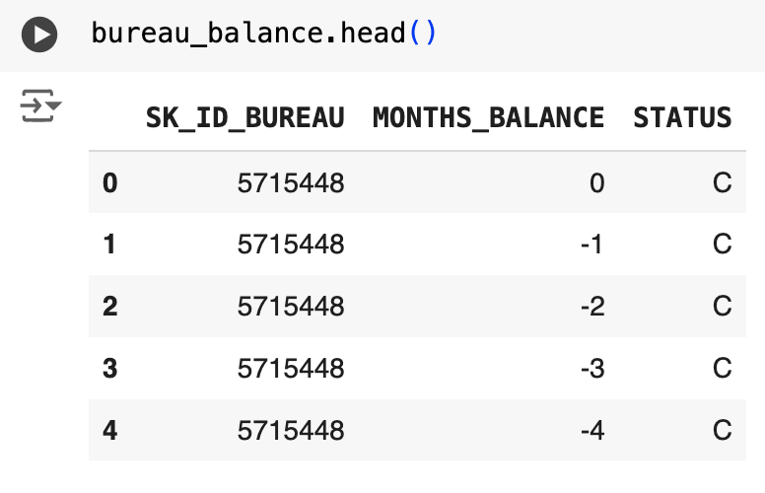
Credit Bureau dataset
Bureau data
Bureau balance data

Slide 6
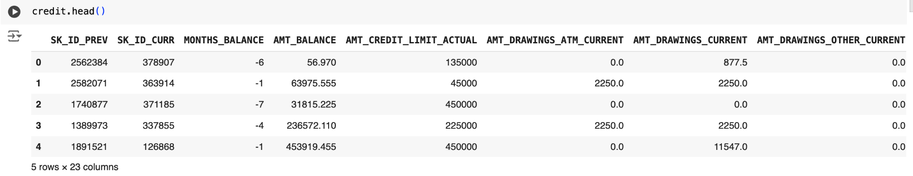
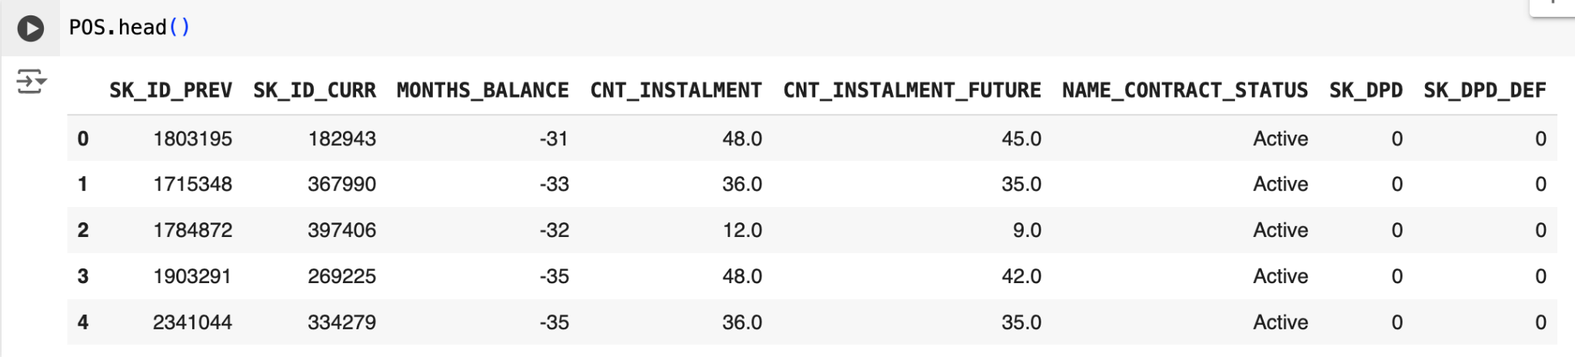
Credit Card & POS dataset
Credit Card Statements
Point Of Sale Transactions

Slide 7
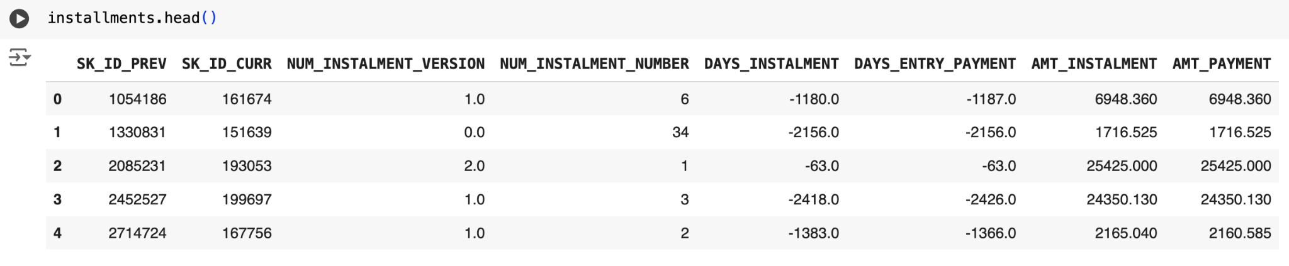
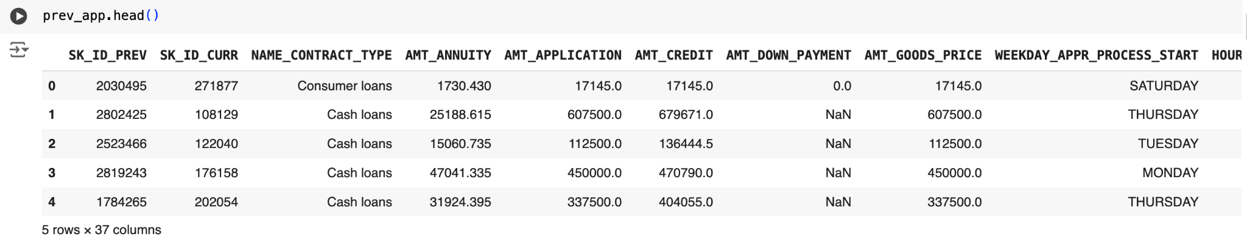
Past transactional dataset
Past Installment payments
Previous Loan Applications

Slide 8
Identification of data source
Data cleaning & pre-processing
Model Training
Output Analysis
Prediction
Feature Selection - EDA
Correlation Matrix: helped decided which features have high correlation and drop the least important one
Feature Engineering: used a threshold of 0.15 (global standard) to see feature importance
Data Integration: Aggregate, if required, and merge data across sources to create a unified dataset. This may involve joining customer data with transaction data or bureau data and other data sets for a comprehensive view.
Encoding Categorical Variables
Label Encoding:
For binary or ordinal categories (e.g., account status: active/inactive), encode with label encoding.
One-Hot Encoding:
For non-ordinal categorical data with multiple categories (e.g., country, transaction type), use one-hot encoding to avoid introducing bias.

Slide 9
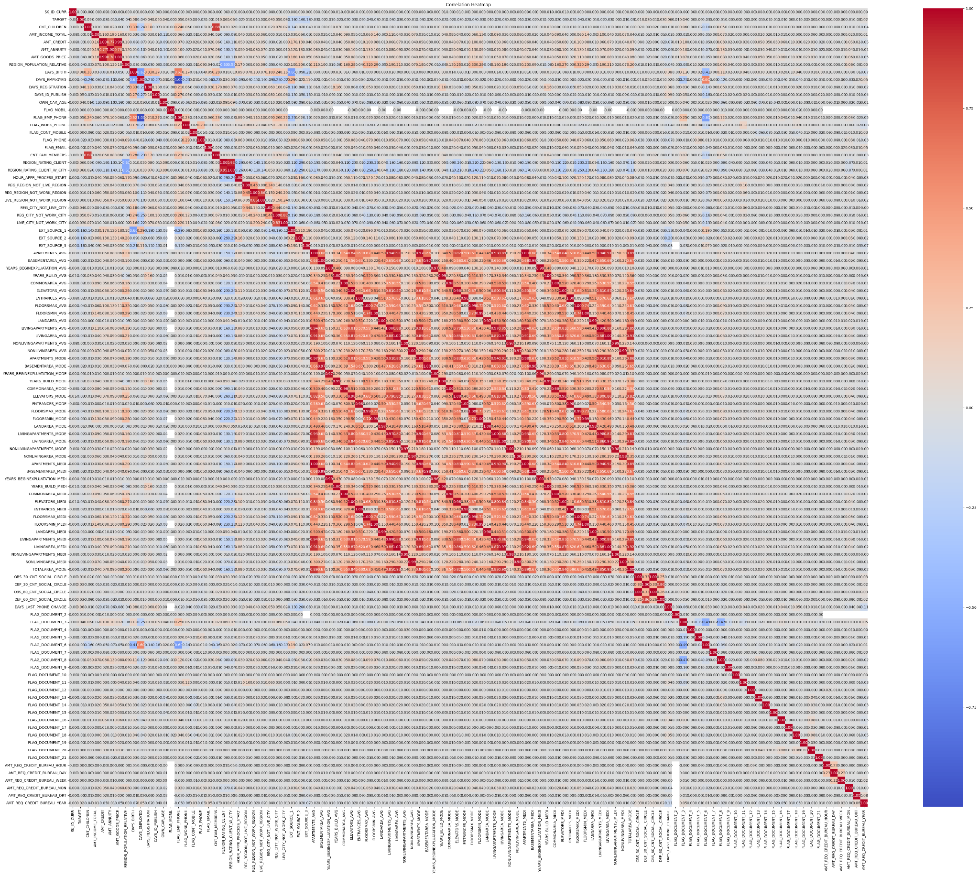
EDA on Application Data
Analysis using Correlation matrix
Dropped around 38 features from both the application datasets as they are having stronger (>90%) correlations

Slide 10
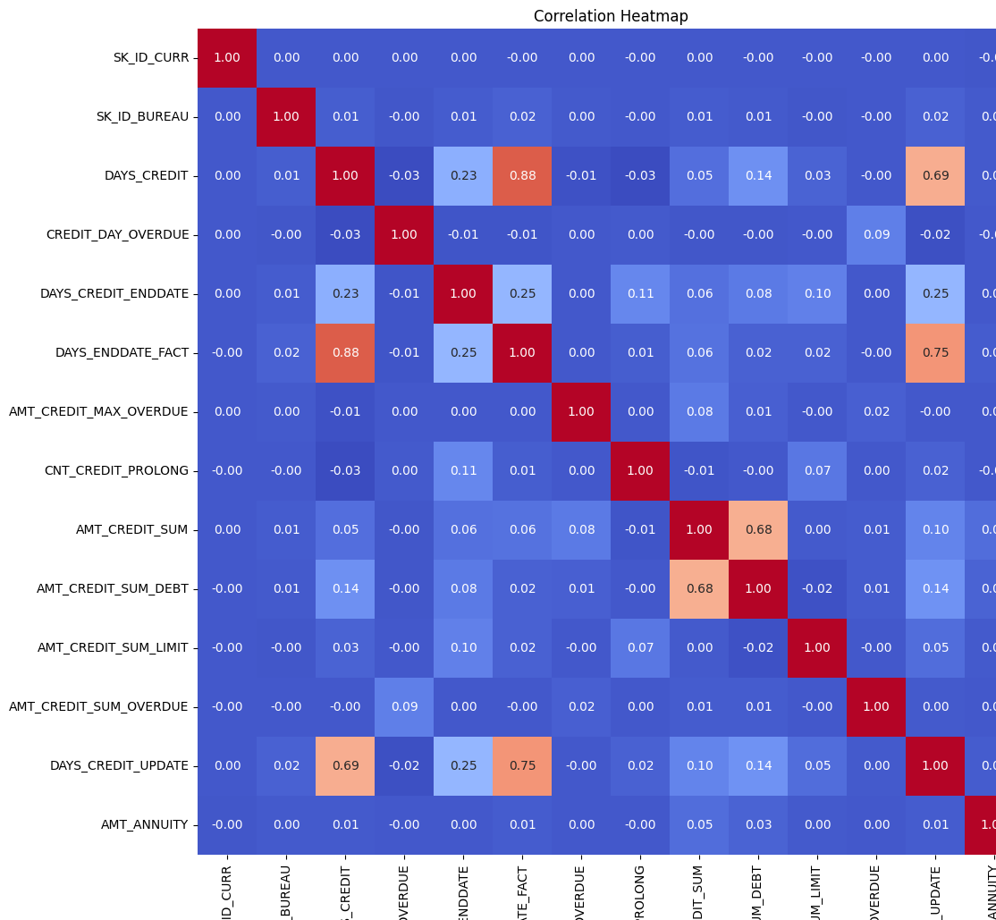
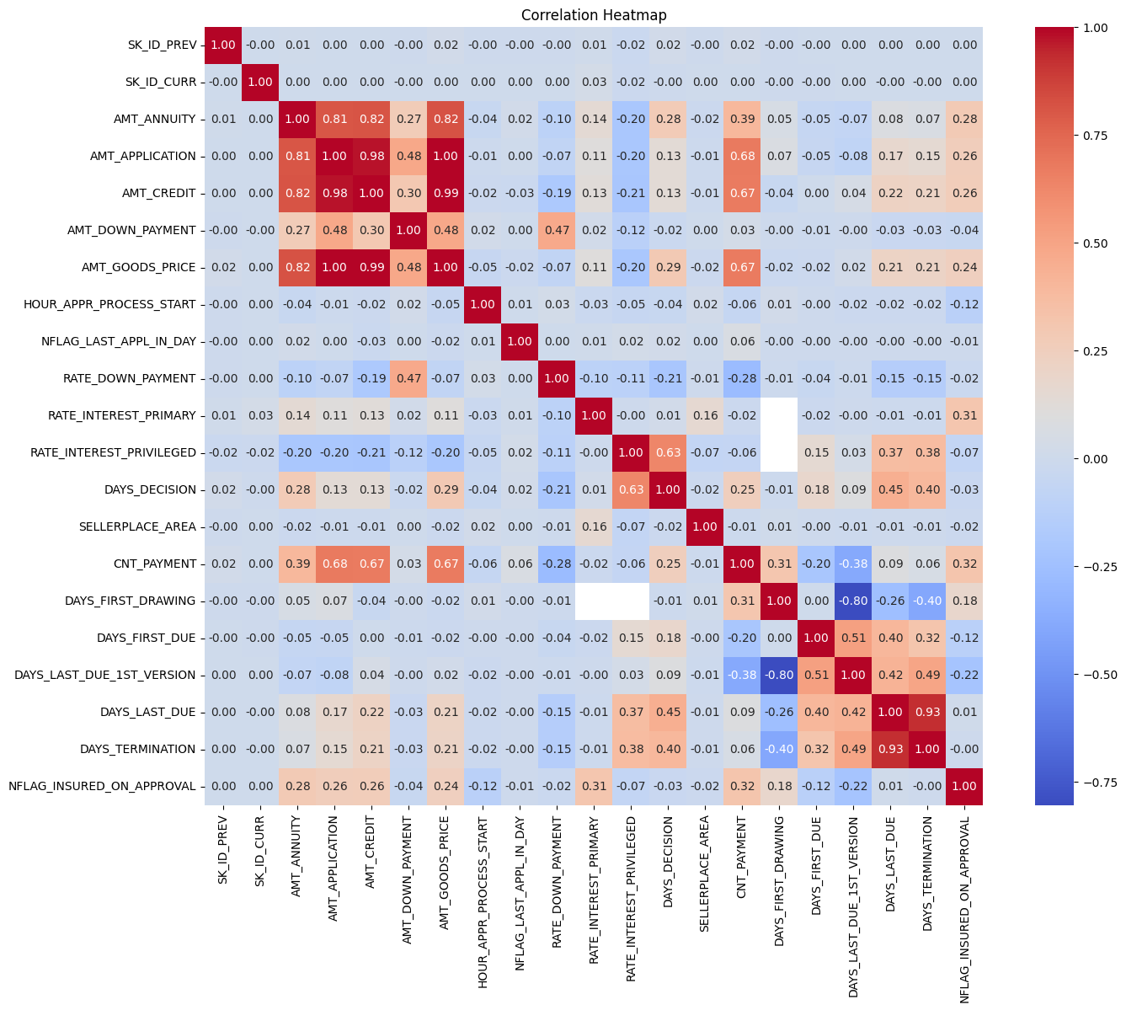
EDA on Bureau & Previous Application Data
Bureau Data: No features are strongly correlated hence no features are dropped from the dataset
Previous Application Data: Below features are dropped as they have strong correlations: DAYS_LAST_DUE, AMT_GOODS_PRICE, AMT_APPLICATION

Slide 11
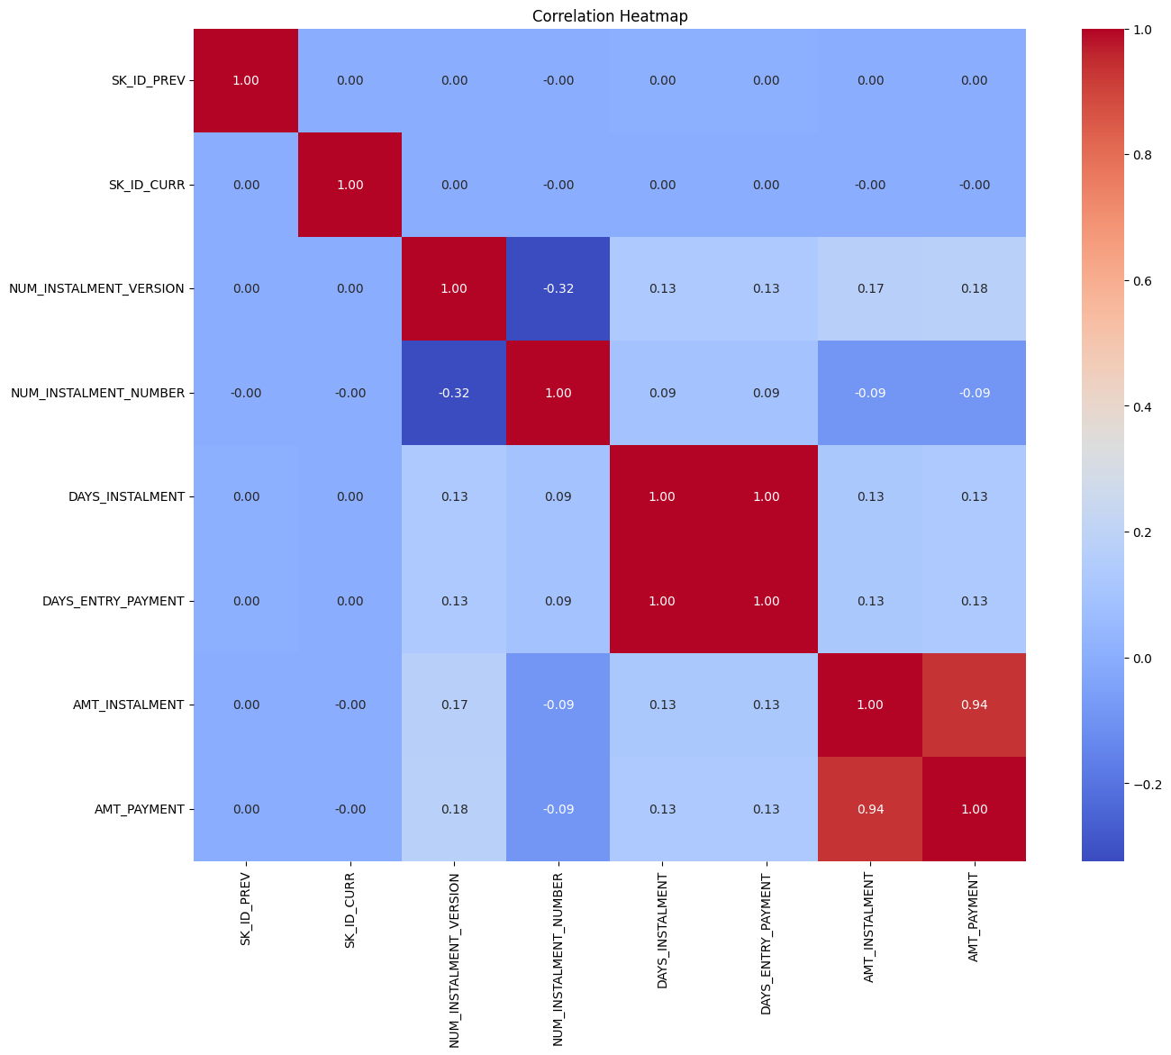
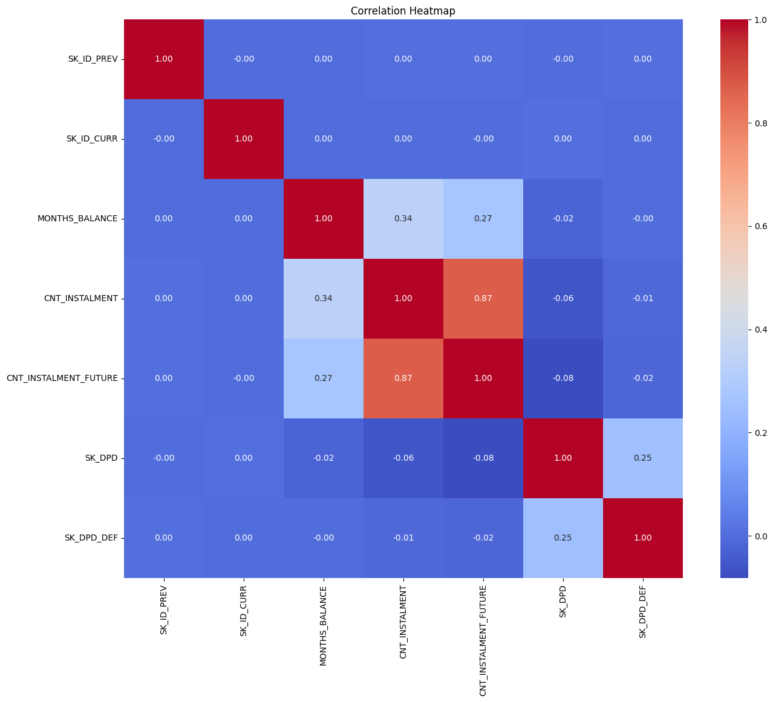
EDA on Installments & POS Data
Installment data: Below features are dropped as they have strong correlations: DAYS_ENTRY_PAYMENT & AMT_INSTALMENT
Point of sale data: No features are strongly correlated hence no features are dropped from the dataset

Slide 12
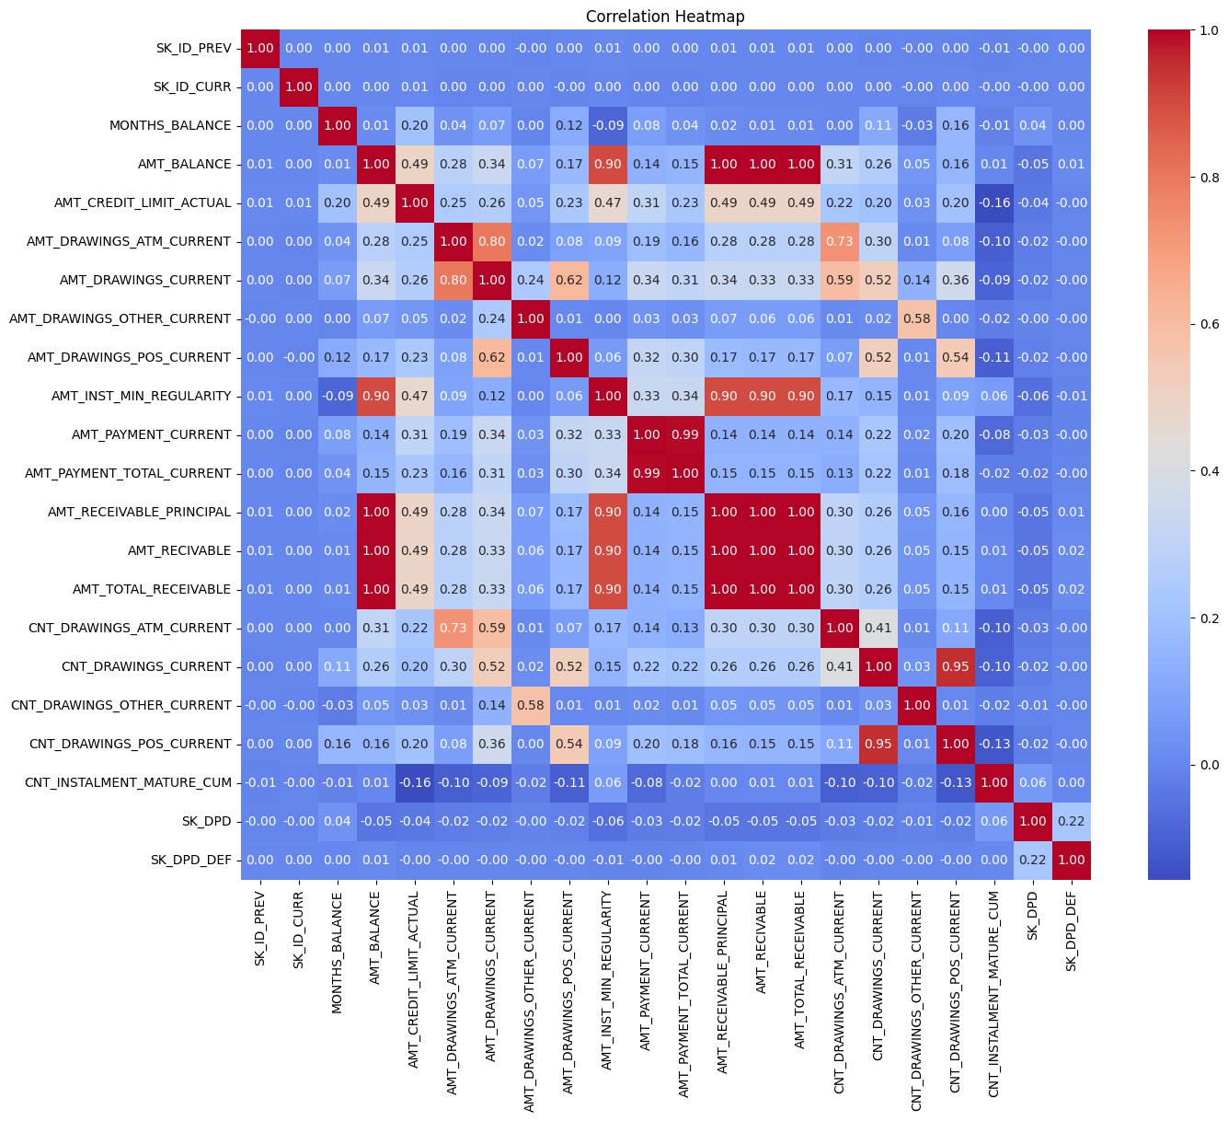
EDA on Credit Bureau Data
Below features are dropped as they have strong correlations: SK_ID_PREV, AMT_PAYMENT_CURRENT, CNT_DRAWINGS_POS_CURRENT, AMT_RECEIVABLE_PRINCIPAL, AMT_RECIVABLE, AMT_DRAWINGS_ATM_CURRENT.

Slide 13
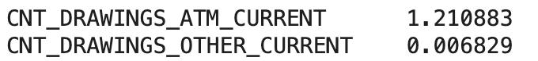
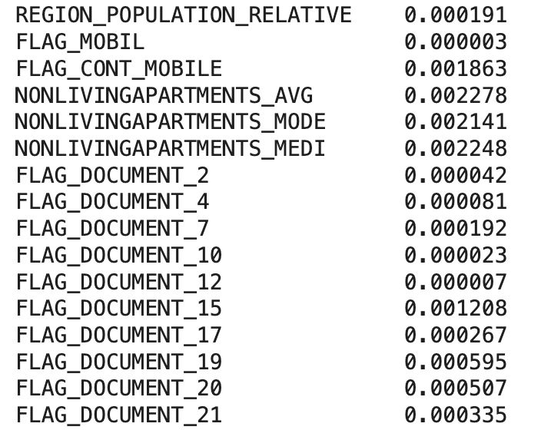
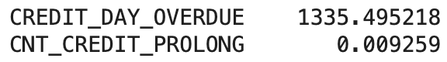
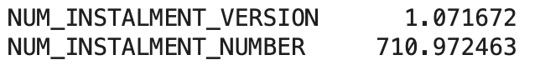

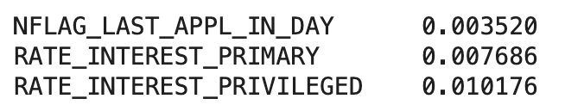
Feature Engineering (all data set)
Credit Bureau
Loan Application Datasets
Bureau
Installments
Point of Sale
Previous Application

Slide 14
Data pre-processing (all data set)
Data Cleaning
Missing Values Handling:
Impute missing values with domain-appropriate values (e.g., mean/median for continuous data, most frequent for categorical).
For this data imputed 0.0 instead
Remove Duplicates:
Check for and remove duplicate transactions or customer records to avoid bias and inflated data.
Outlier Detection:
Identify and handle outliers, especially in transaction amounts or high-risk fields. Outliers in fraud detection are tricky: while they can indicate fraud, they can also be legitimate extreme values. So for this case, did not drop any outliers
Data Scaling:
Standardize Data
Each feature is scaled and puts into into a balanced scale
Allows for you to makes sure you are analyzing the features on a balanced scale
Dimensionality Reduction:
Principal component analysis (PCA): Used to reduce the number of features through dimensionality reduction and keeps the important features

Slide 15
Identification of data source
Data cleaning & pre-processing
Model Training
Output Analysis
Prediction
To enhance accuracy, and reliability of our Fraud detection system, we have tested accuracy of various ML models with our finalized dataset. Below are the list of models we used for training and testing:
Logistic Regression
Decision Tree
Random Forest
Artificial Neural Network

Slide 16
Identification of data source
Data cleaning & pre-processing
Model Training
Output Analysis
Prediction
 | Test Accuracy | Validation Accuracy | Output Analysis
Logistic Regression | 93.02% | 93.14% | Performance is good and stable,
Decision Tree | 86.08% | 86.19% | Lowest performing model.
Random Forest | 93.03% | 93.11% | Best performing model
ANN | 92.82% | 92.90% | Not as good as other two models
Based on the accuracy of both test data sets and validation data sets, we recommend to use Random Forest. Random forest is the best performing model it is also a stable model as the difference between test and validation accuracy is lowest.

Slide 17
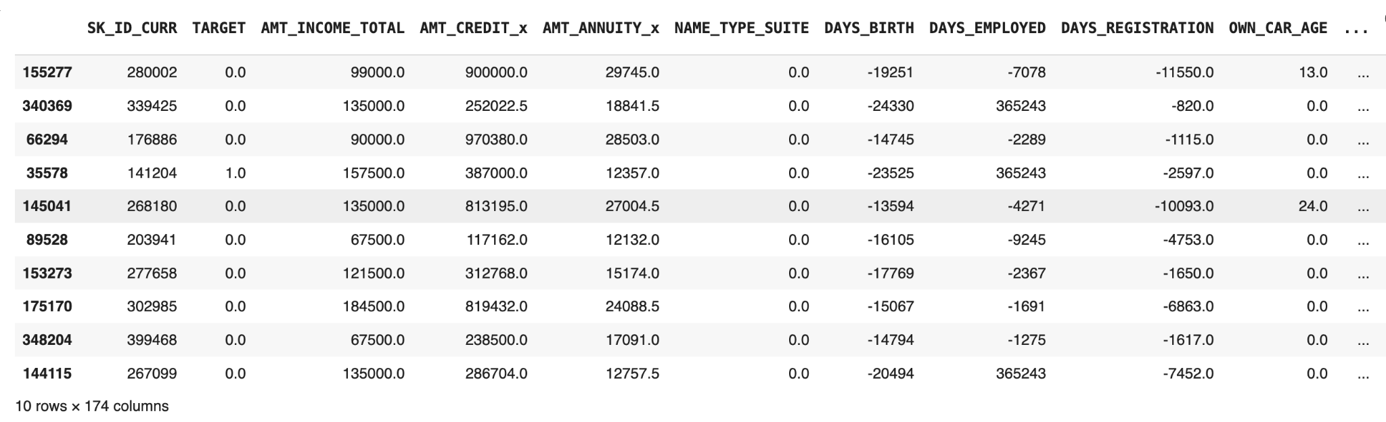
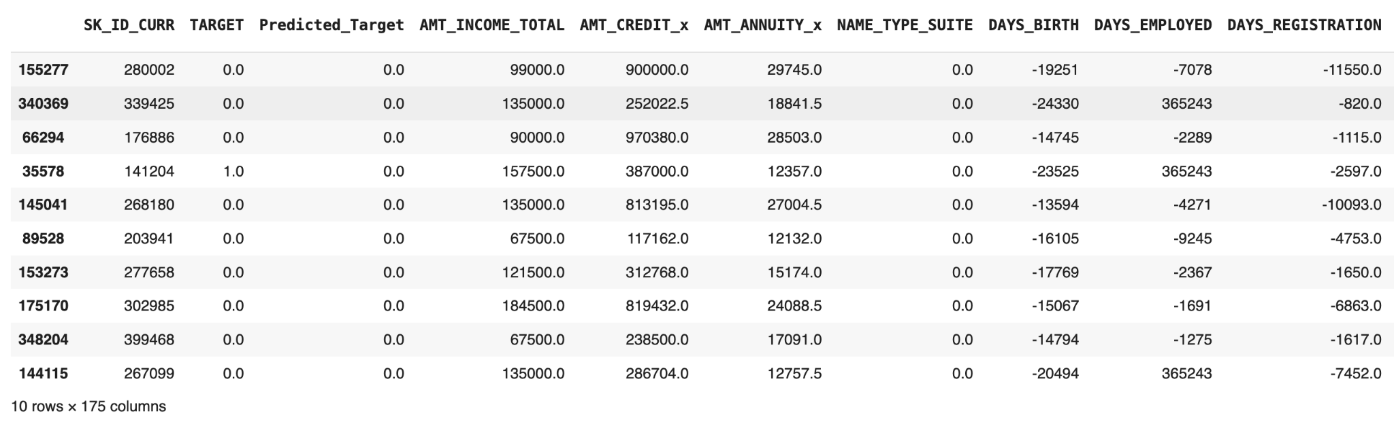
Identification of data source
Data cleaning & pre-processing
Model Training
Output Analysis
Prediction
Let’s predict fraudulent transaction with below data using the trained random forest model
In the predicted results, we observe that a transaction initially classified as fraudulent is now being identified by the model as a legitimate transaction.

Slide 18
Analysis of predicted result
It’s observed that one record was initially marked as a fraudulent, however let’s look few features closely:
DAYS_EMPLOYED 365243
AMT_INCOME_TOTAL 157500.0
DAYS_BIRTH -23525
AMT_CREDIT_SUM 683100.0
AMT_CREDIT_SUM_DEBT 499891.5
These are some features that are considered when checking for fraud. These features are reasons why the fourth row was predicted to be non fraudulent. The number of day employed indicate the client has been employed for years. The DAYS_BIRTH indicate that the person is in their 60s. AMT_CREDIT_SUM and AMT_CREDIT_SUM_DEBT indicate a good financial background with high credit sum with low debt. These are some major factors that are considered when checking for fraud and all these point to a strong indication of non fraudulent activity.

Slide 19


Thank You !!
Chakrika Vemireddy

